Slide 1

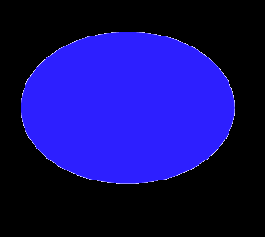
Like This:

Slide 2
Reward:
1

Slide 3
No Reward:
0

Slide 4


Like This:

